Slide 1

FixFlow
Maintenance management app
CS691

Slide 2
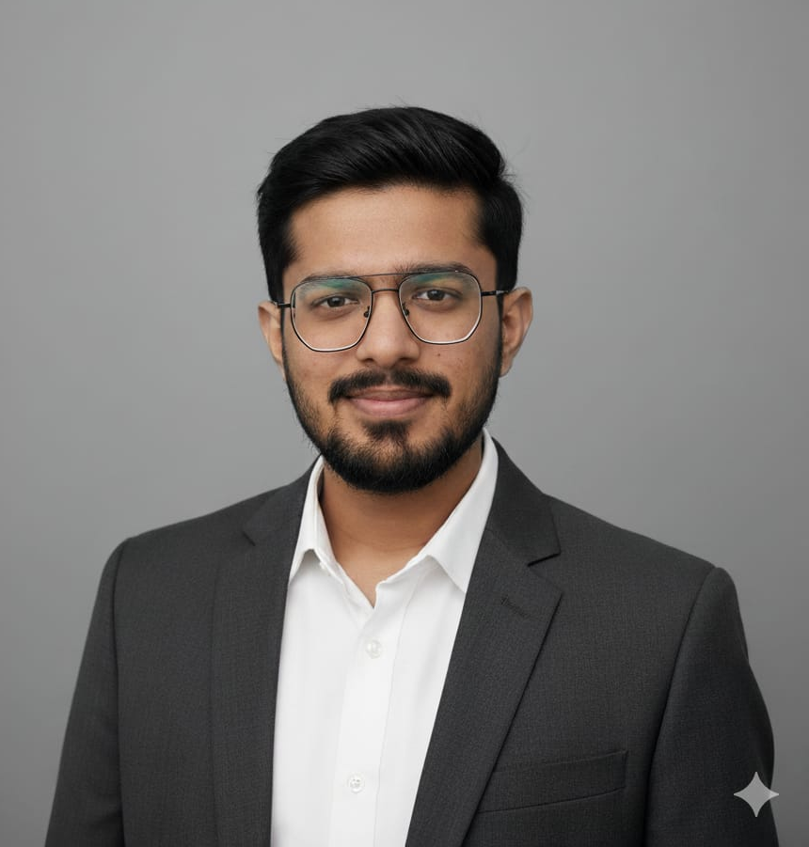
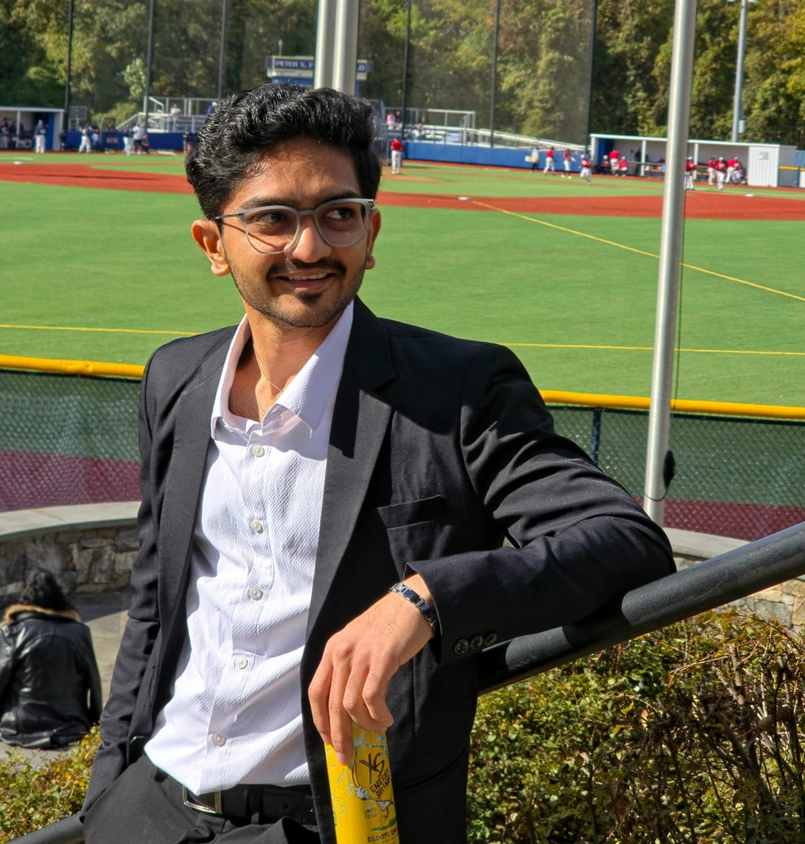
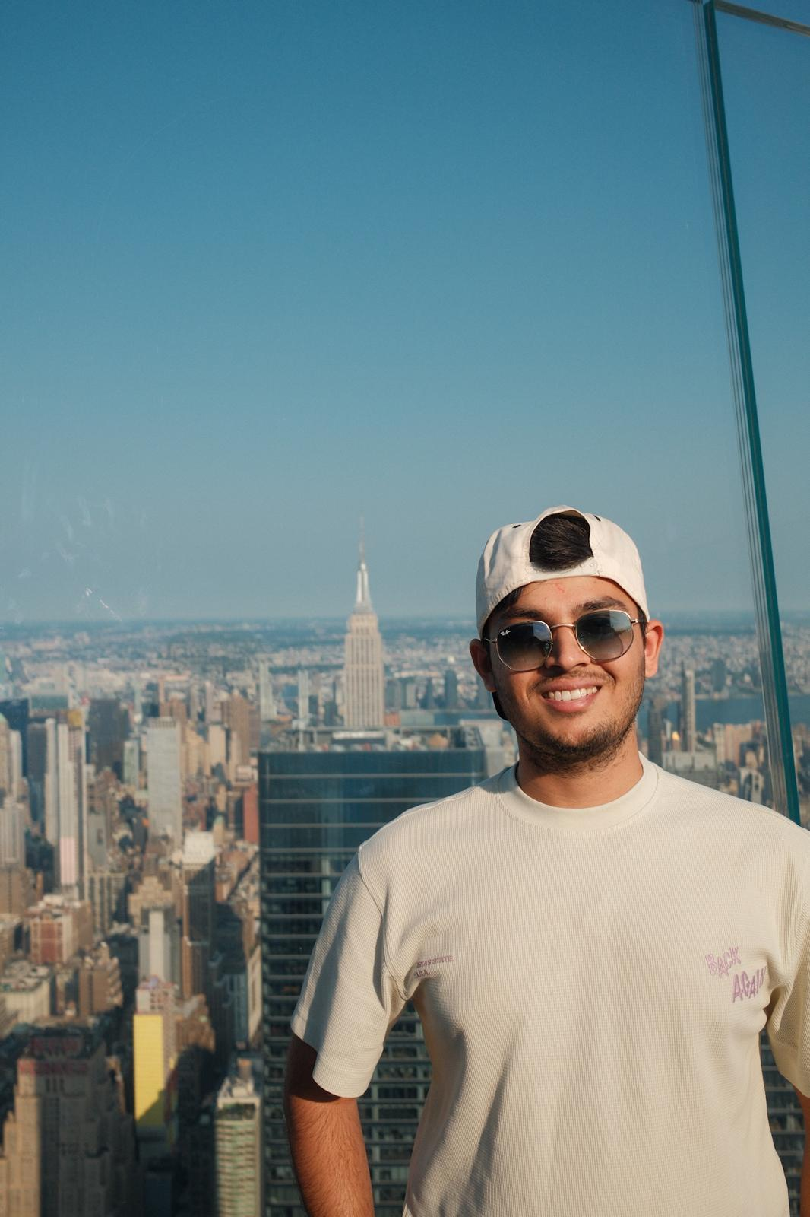
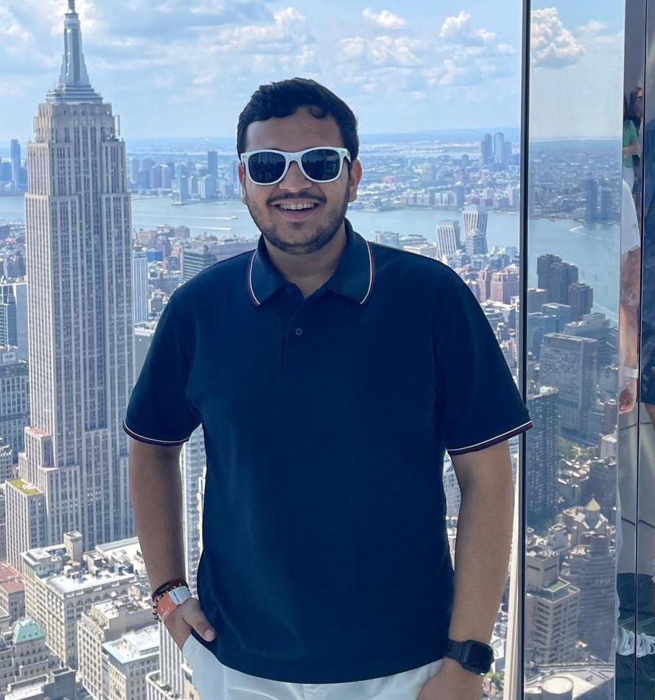
Team members
Viraj Choksi
Cloud & DevOps
Harshil Goti
Backend & Data Administrator
Shriken Patel
Frontend/ML Developer
Krish Jasani
Product & QA

Slide 3

Agenda
Problem Statement
Product Description
Personas
Technology Description
Project timeline
Team Agreement
Retrospective
Wiki-Page Link

Slide 4
Problem Statement
Current maintenance reporting in high-density residential environments, such as dorms and apartment complexes, is hindered by fragmented communication and a lack of visual context. Property managers often rely on vague, text-only requests that fail to specify the severity or technical requirements of an issue. This "information gap" leads to significant operational inefficiency, most notably the "double-trip" phenomenon, where technicians arrive unprepared and must return later with the correct tools, thereby doubling labor costs and delaying essential repairs.
Beyond physical maintenance hurdles, the lack of a centralized digital system creates an accountability and transparency crisis. Tenants often feel ignored due to the absence of real-time status updates, while management lacks the structured data needed to track response times or identify recurring infrastructure failures. Without a documented audit trail, buildings face increased risks of property damage and liability, making it nearly impossible for administrators to optimize their workflows or verify compliance with safety standards.

Slide 5
Product Description
FixFlow is a mobile-first maintenance management ecosystem designed to eliminate the inefficiencies of traditional facility reporting through a photo-centric, "smart triage" approach. By mandating visual evidence during the submission process and utilizing a backend priority engine, the platform automatically categorizes and ranks work orders based on severity, ensuring that critical issues like leaks or electrical hazards are addressed immediately. The system bridges the gap between residents and management by providing tenants with live status tracking and administrators with a data-rich dashboard, backed by a robust audit log that ensures 100% transparency and accountability for every repair.

Slide 6

Persona 1
Profile: Marcus is a 20-year-old Junior at Pace University living in an on-campus residence hall. He is a full-time student with a heavy course load and a part-time job. He doesn't have time to wait on hold with campus security or visit the facilities office in person. He relies entirely on his smartphone to manage his life.
Name: Marcus
Age: 20
Location: New York, NY (Pace University Housing)
Status: Student / Resident
Tech Literacy: High (Prefers apps over phone calls)
Living Situation: Shared Suite
Frustrations:
Not knowing if his maintenance request was actually received.
Maintenance staff showing up when he is in the middle of a remote exam.
Having to explain the same issue multiple times to different people.
Goals:
Reporting a problem in under 30 seconds.
Getting real-time notifications about when a technician will arrive.
Having a functional, safe living space to study in.

Slide 7
Persona 2
Profile: David is a 45-year-old lead maintenance technician with 15 years of experience. He is skilled at his job but often frustrated by the lack of information in work orders. He hates arriving at a "clogged sink" only to realize he needs a specific industrial snake tool that he left back at the central workshop, 15 minutes away.
Name: David
Age: 45
Location: Westchester, NY
Job: Facilities Technician
Work Style: Practical, hands-on, mobile.
Family: Married with two kids.
Frustrations:
Walking across a large campus only to find he brought the wrong tools for the job.
Illegible handwritten notes or vague descriptions like "it's broken."
Getting blamed for delays when he wasn't notified of a priority emergency.
Goals:
Seeing a photo of the issue before he leaves the shop to prepare.
Closing out tickets digitally so he doesn't have to do paperwork at the end of the day.
Efficiently completing his daily route to reduce overtime.

Slide 8

Persona 3
Profile: Elena is a 38-year-old Property Manager responsible for three large dormitory buildings. She needs to keep costs low and resident satisfaction high. She cares about "the big picture"—knowing which buildings have the most issues and ensuring her team is working efficiently. She is the person who will be interested in the "Audit Logs" you mentioned.
Name: Elena
Age: 38
Location: New York, NY
Job: Senior Property Manager
Tech Literacy: Moderate (Wants clean, easy-to-read data)
Interests: Data analytics, budget optimization.
Frustrations:
Having no clear data on how long it takes for a ticket to go from "Open" to "Closed."
Dealing with angry parents/residents complaining about ignored requests.
Unpredictable repair costs caused by small issues turning into major floods.
Goals:
Identifying recurring issues (e.g., "Building B has constant pipe leaks") to justify renovations.
Ensuring the maintenance team is meeting their Service Level Agreements (SLAs).
Maintaining a 100% digital audit trail for liability and safety compliance.

Slide 9

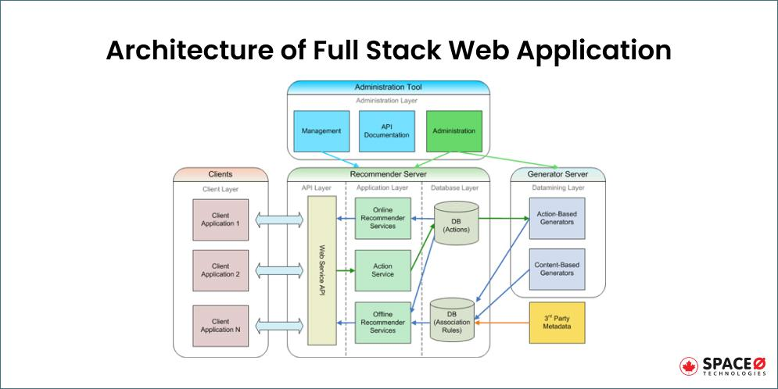






Technology Description
React JS
TensorFlow
MongoDB
AWS
Github
Docker
Express JS

Slide 10
Project Timeline
Sprint | Task Name | Assigned To | Status | Priority | Est. (Days)
Sprint 1 | Feb 8 - Feb 18 |  |  |  | Total: 14
 | Finalize Project Proposal & Team Agreement | Krish Jasani | Done | High | 3
 | System Architecture Design (Node.js/React) | Harshil Goti | Done | High | 4
 | Set up GitHub Repo & Project Boards | Shriken Patel | Done | Medium | 2
 | Initial Database Schema (MongoDB) | Viraj Chokshi | Done | High | 3
 | Deliverable 1 Submission | Viraj Chokshi | Working on it | Medium | 2
Sprint 2 | Feb 18 - Mar 4
 | User Authentication & JWT Auth | Harshil Goti | Not Started | High | 4
 | Frontend UI Mockups & Material UI Setup | Shriken Patel | Not Started | Medium | 3
 | REST API Setup (CRUD for HomeHub) | Harshil Goti | Not Started | High | 4
 | AWS Setup & Docker Configuration | Viraj Chokshi | Not Started | Low | 3

Slide 11
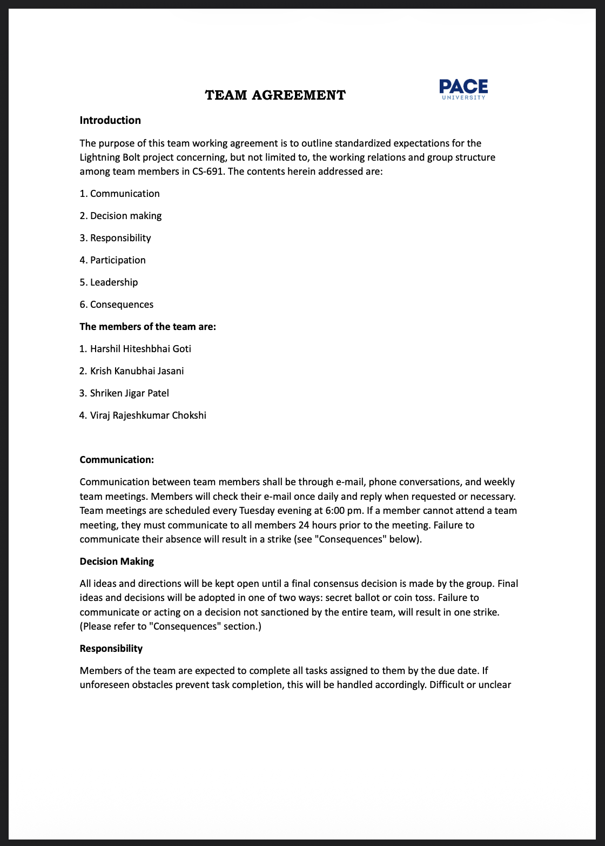
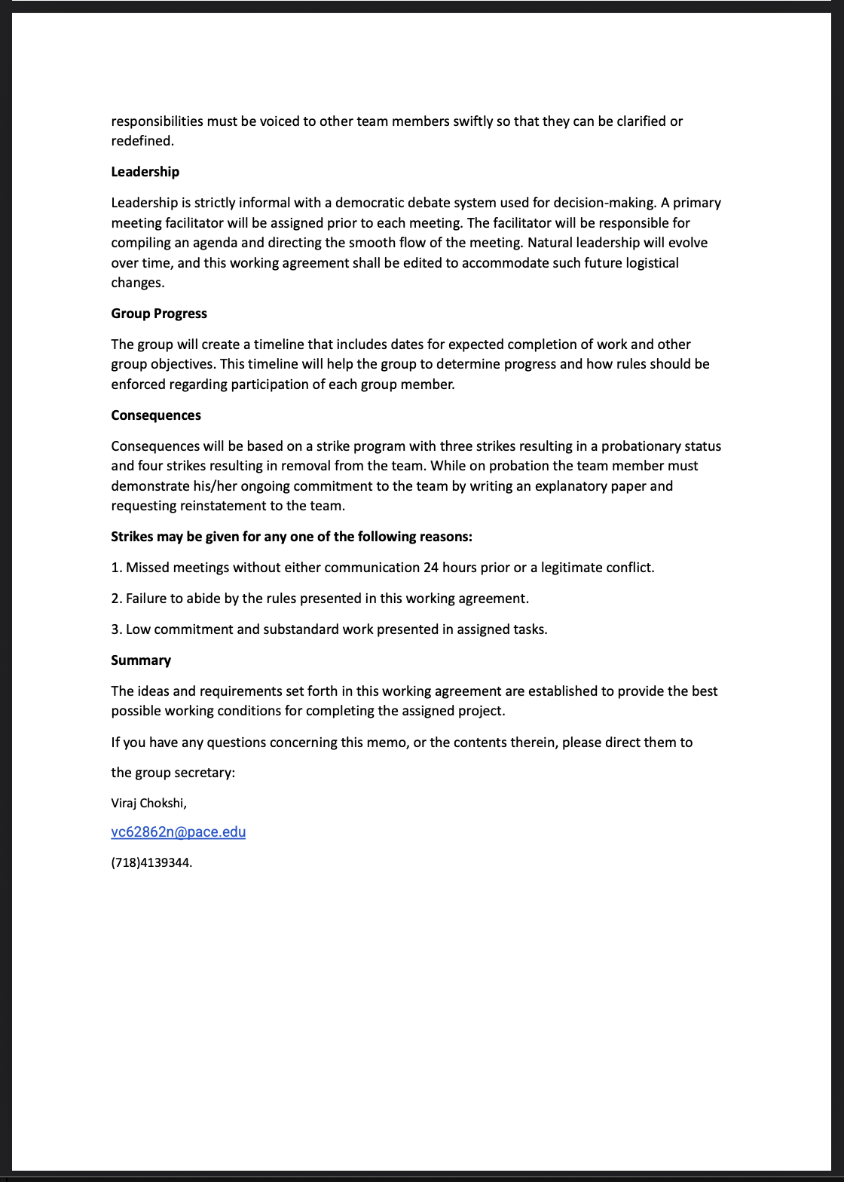
Team Agreement

Slide 12
Retrospective
What went well?
We as a team have planned to keep our objective simple to finish and produce what was expected.
Team had good time working together.
Active response from team to get involved in tasks with clear thoughts.
The key was participation and motivation to complete task in time and every member knew what they had to do.
We had several discussion sessions.
Overall, every meeting session is effectively used to gain progress and complete sprint on time.

Slide 13
What Could Be Improved?
We frequently try to communicate to discuss about project and advancements even after the sprint completion.
Setting up time limit for the tasks and learning from previous semester student’s sprints performance to make improvements and where can we be better.
What we plan to commit for next sprint?
Maintain consistency in performance, improvement is key.
Previous students sprint retro can be helpful for improving team balance in which areas team is lacking, where we can work according to that.
Previous retro stats can be helpful in filling the gaps of next sprint.

Slide 14
Group Wiki-Page Link
https://github.com/Virajchokshi/FixFlow/wiki

Slide 15
Thank You !

